Slide 1

Trivel
A Travel Agency

Slide 2
Trivel
We received an email from Cai with the attached document to create an app for a fictitious company
Hello,
I need you to make an app for a travel agency I’m opening. I need the app to have a list of our packages, a wish list, locations for the places, etc. I would also like for the project to be done on GitHub so I can see the progress.
Thanks

Slide 3

Our Ideas
Potion Shop
Development Company
Travel Agency
We ended up deciding on a travel agency and decided on the name Trivel a mix of Trip and Travel

Slide 4

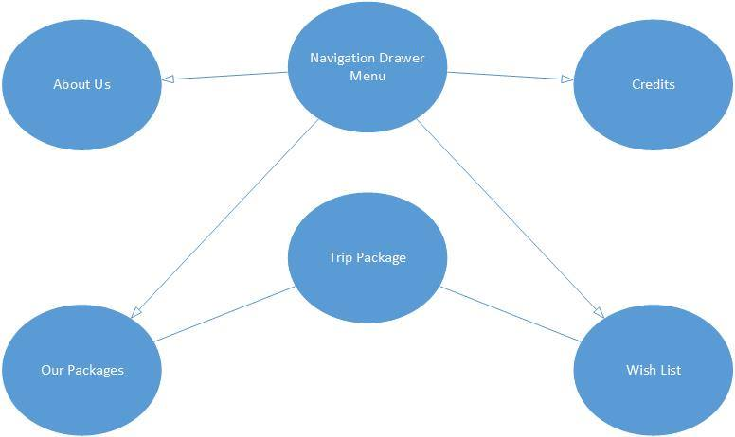
Building of our app

Slide 5
Research on libraries
AboutLibraries
Floating Action Buttons by Clans
Circle Image View
Picasso
Page Indicator View
Card View
Our app uses 6 libraries. AboutLibraries is for our credits, Floating Action Button allows us to have a sub menu when you tap the favorite icon in our packages, Circle Image View is used for our headshots on the About Us page. And Picasso a late edition after talking with Cai helped us improve the app and remove the lag due to the amount of photos in our app. Page Indicator View is used in the trip views and added the indicators located under the images. Card view is used to give us a more professional look in the about us section.

Slide 6
How we split up the app
Packages List
WishList
About Us
Credits
Loading Animation / Splash screen
Trip View
Jose
Nick

Slide 7
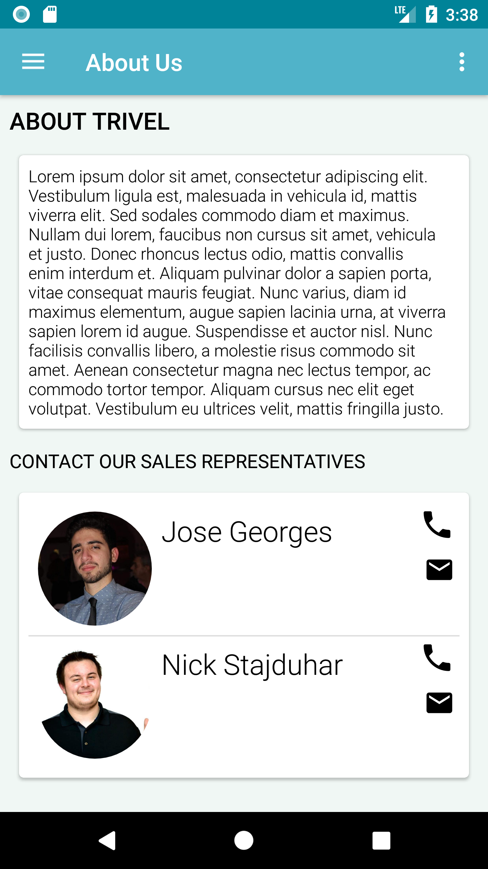
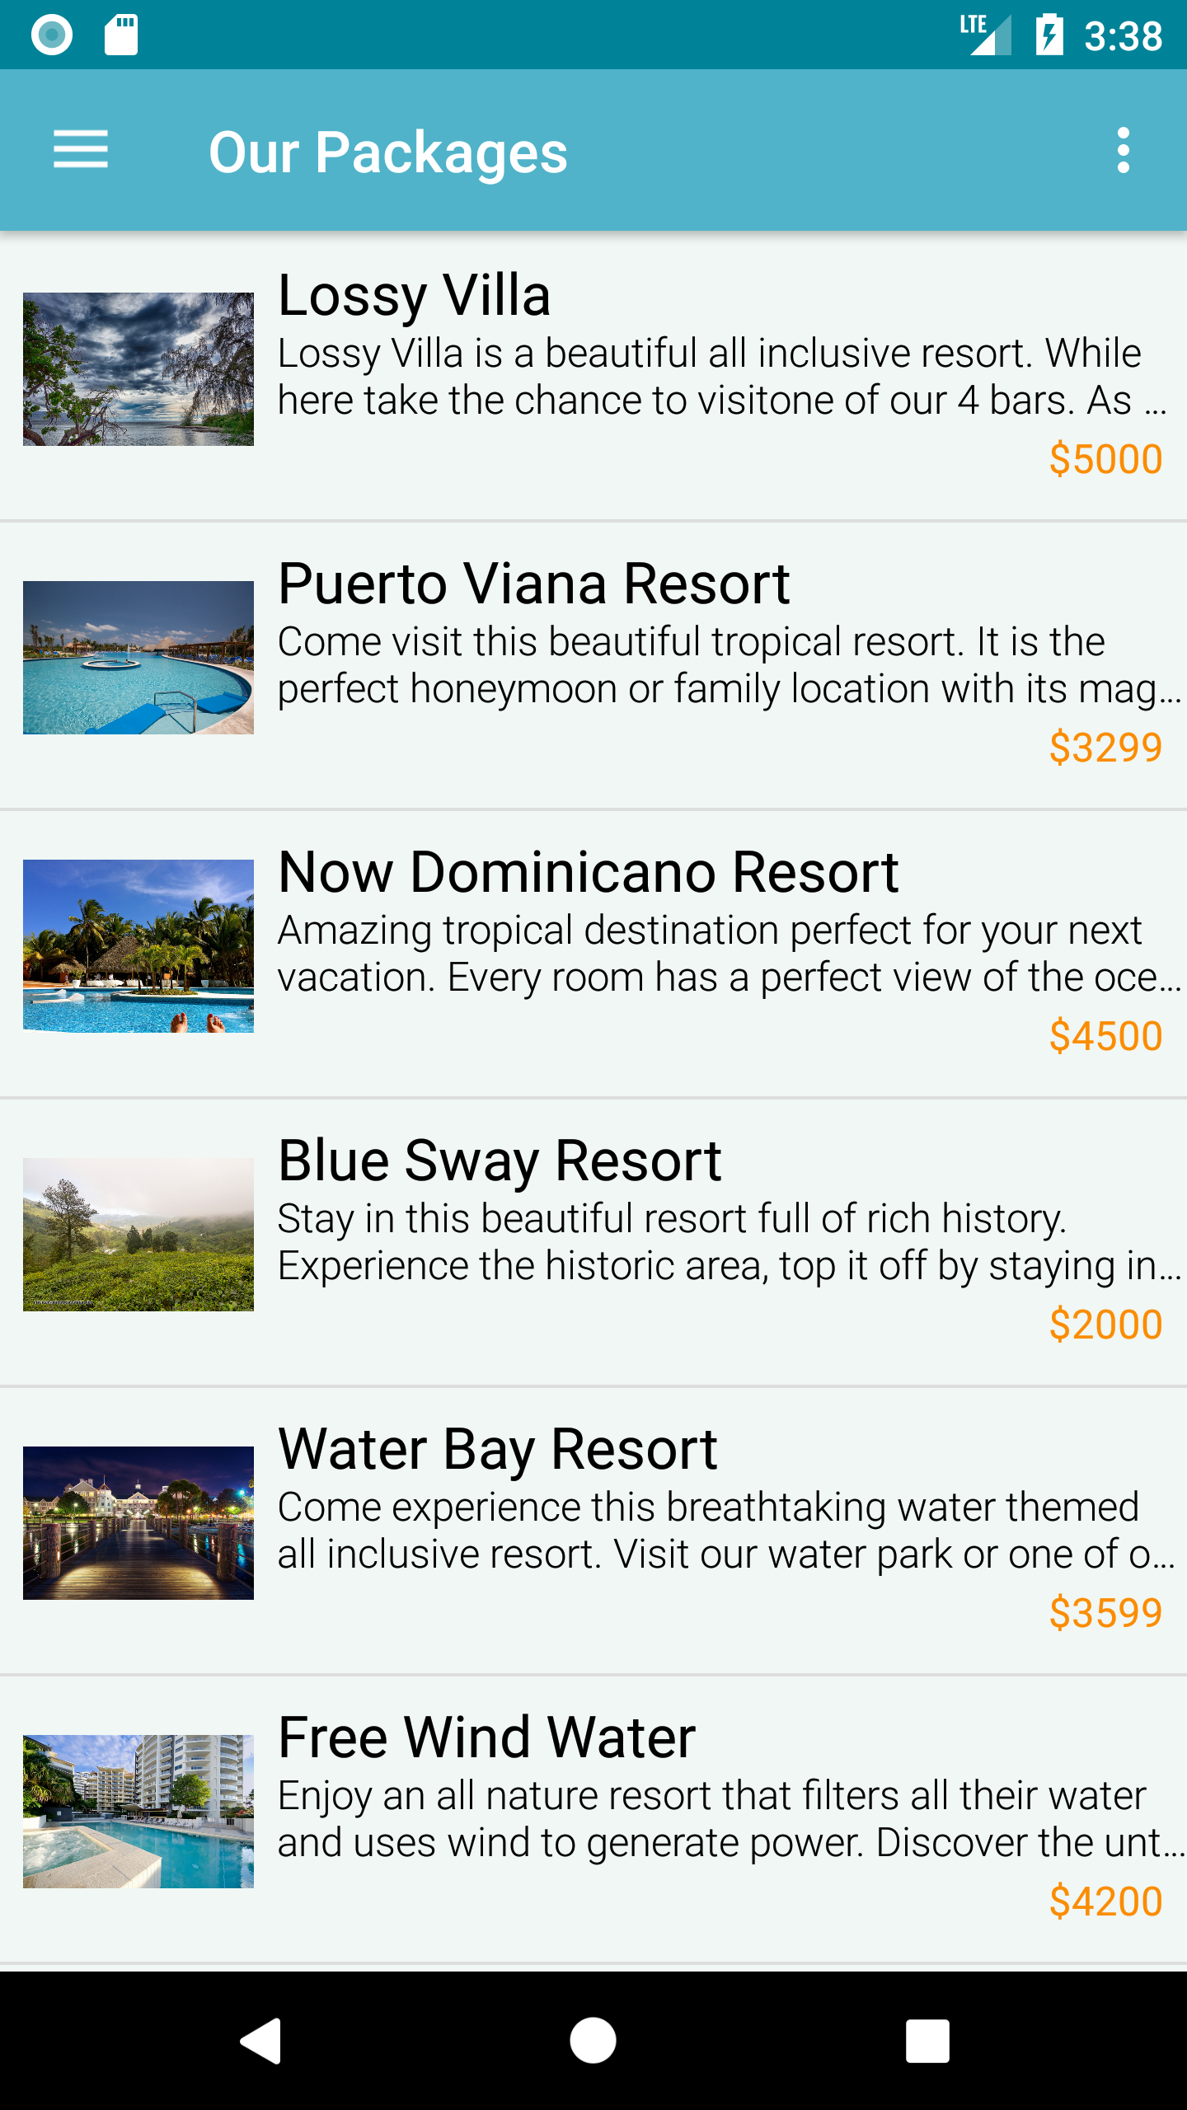
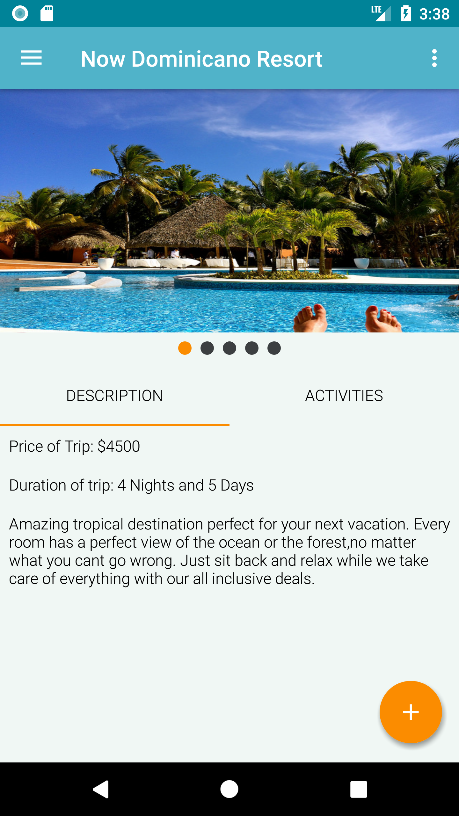
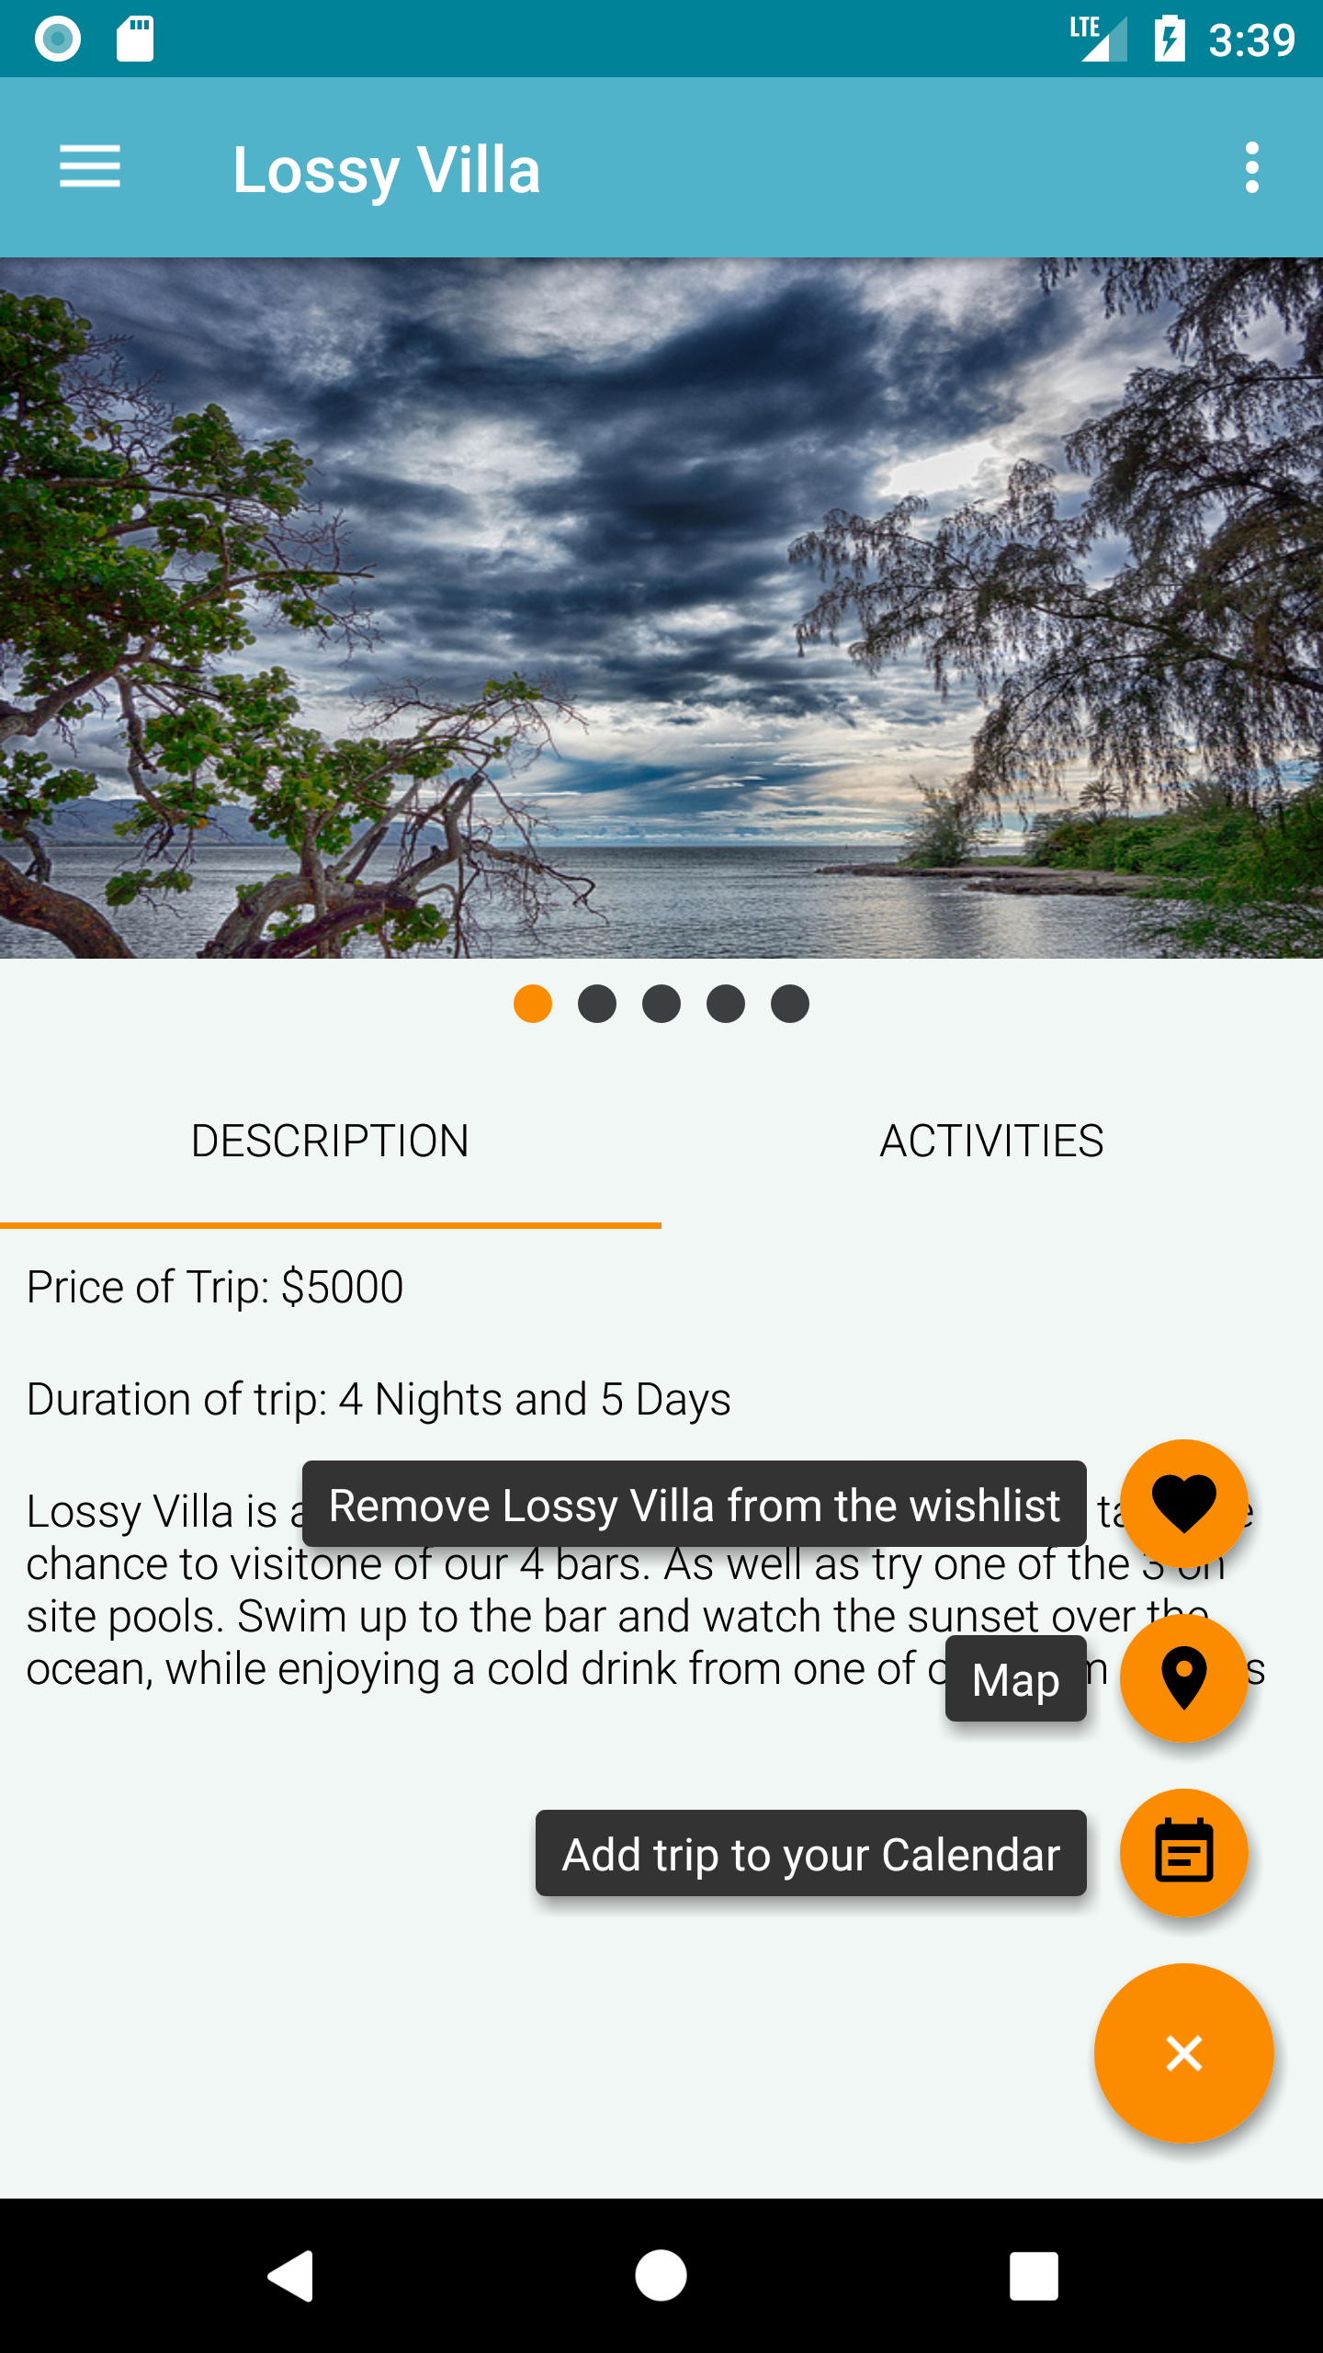
Workload
The app took about 4 weeks to have our finished design and working app. Below are screenshots of the finished product

Slide 8
Weekly Break Down (Week 1)
Discussed the theme of the app
1
Agreed on the type of company
2
Drew up a quick sketch of each fragment and what they would contain
3
Discussed how we would pass the information in between fragments
4

Slide 9
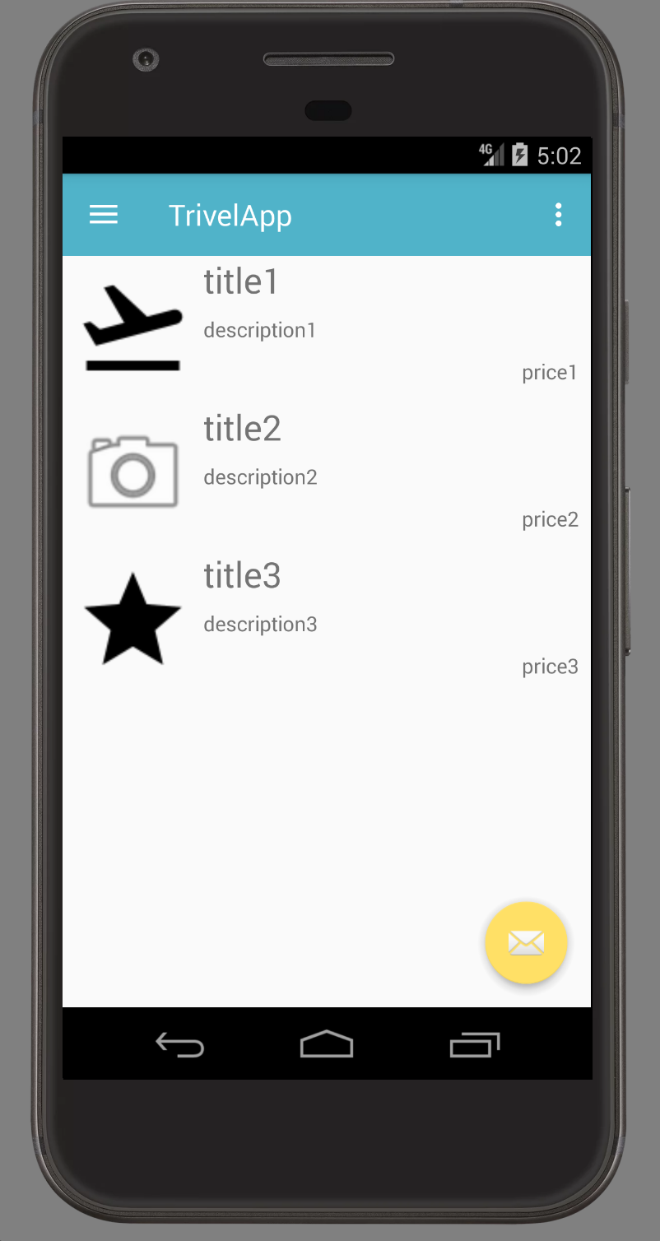
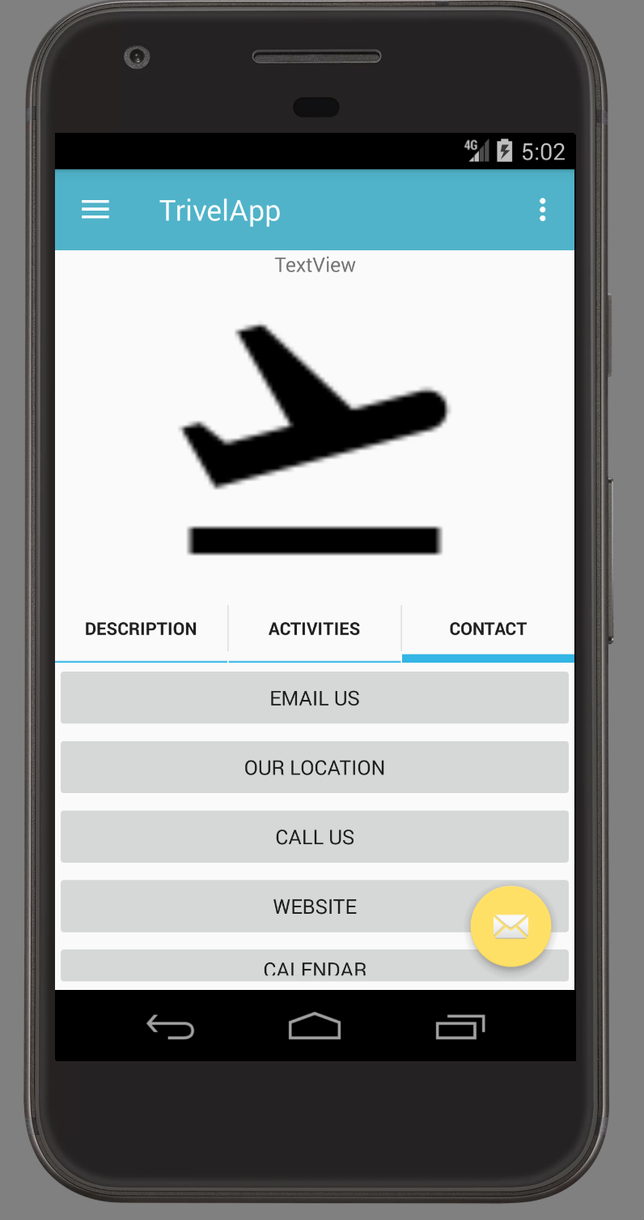
Week 1-2 Results

Slide 10
Weekly Break Down (Week 2)
Implemented an open source library for FAB buttons
1
Deprecated the contact tab from our tab host and move the remaining buttons to a different fragment
2
Managed to pass information needed in between fragments.
3

Slide 11
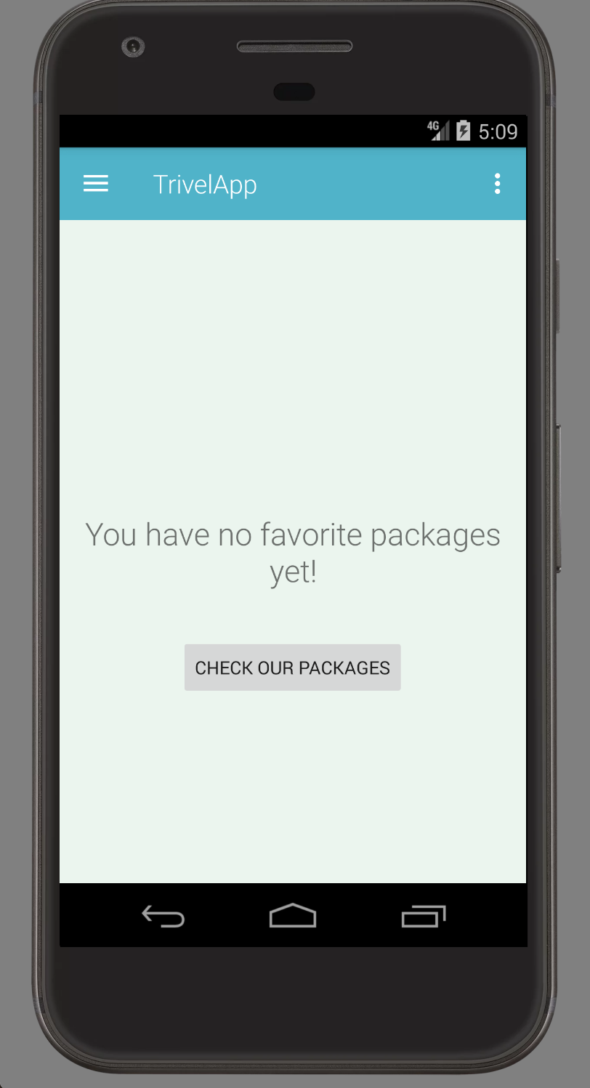
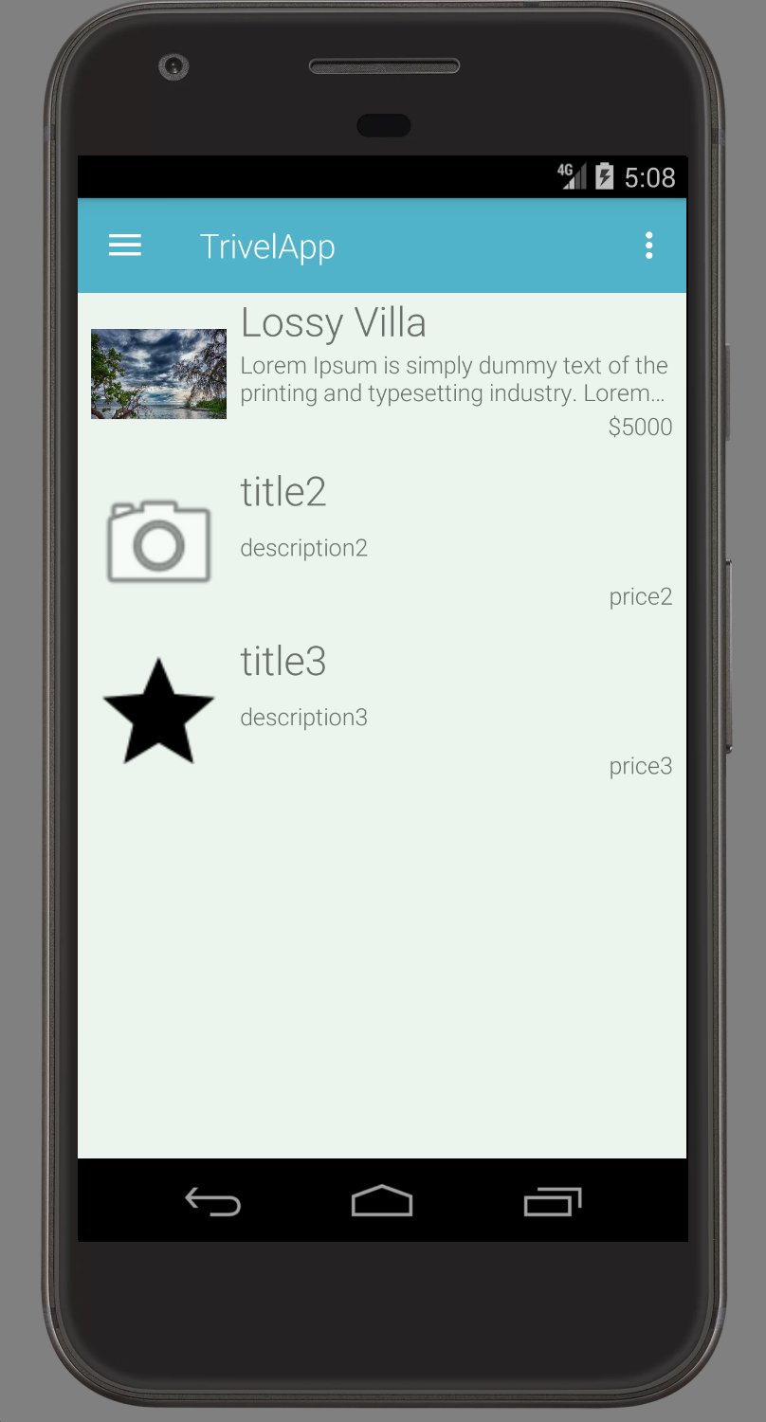
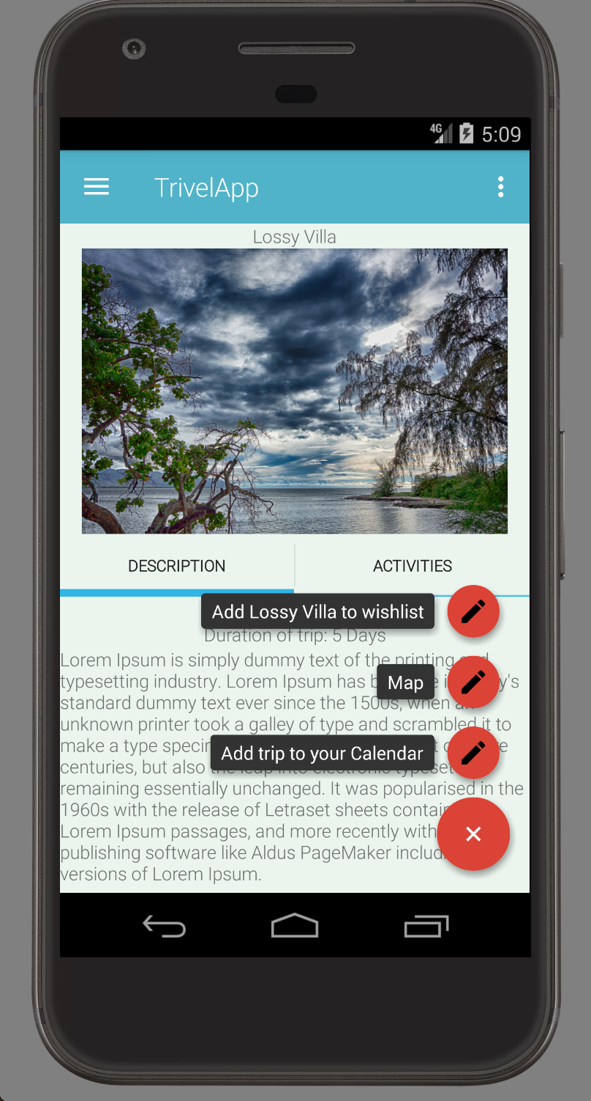
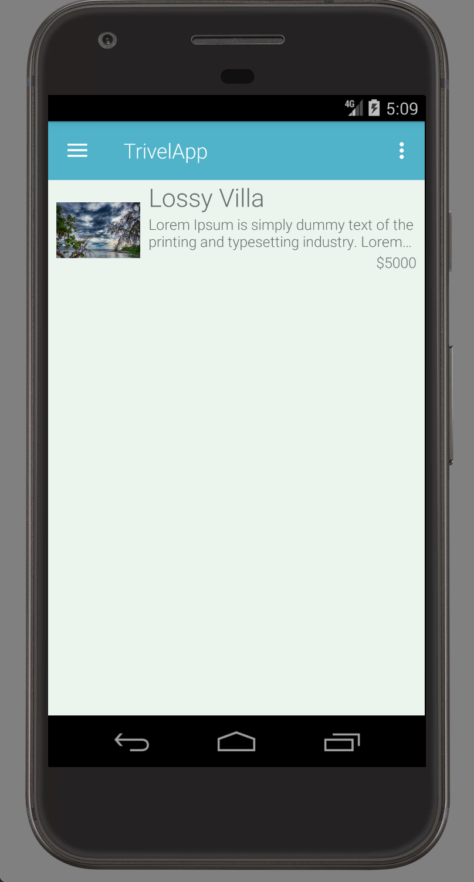
Week 2-3 Results
Single Package View
Wish List (with content)
Wish List (empty)
Our Packages

Slide 12
Weekly Break Down (Week 3)
Discussed what still had to be completed. We decided to work on View Pager Indicators, A Logo, and a Scroll View
1
Added a dependency for PageIndicatorView (romandanylyk)
2
Added a scroll view over the whole trip view this allowed us to have all the content visible on every phone no matter what their screen size is.
3
Jose also found a suitable logo for our app that was Creative Commons
4

Slide 13
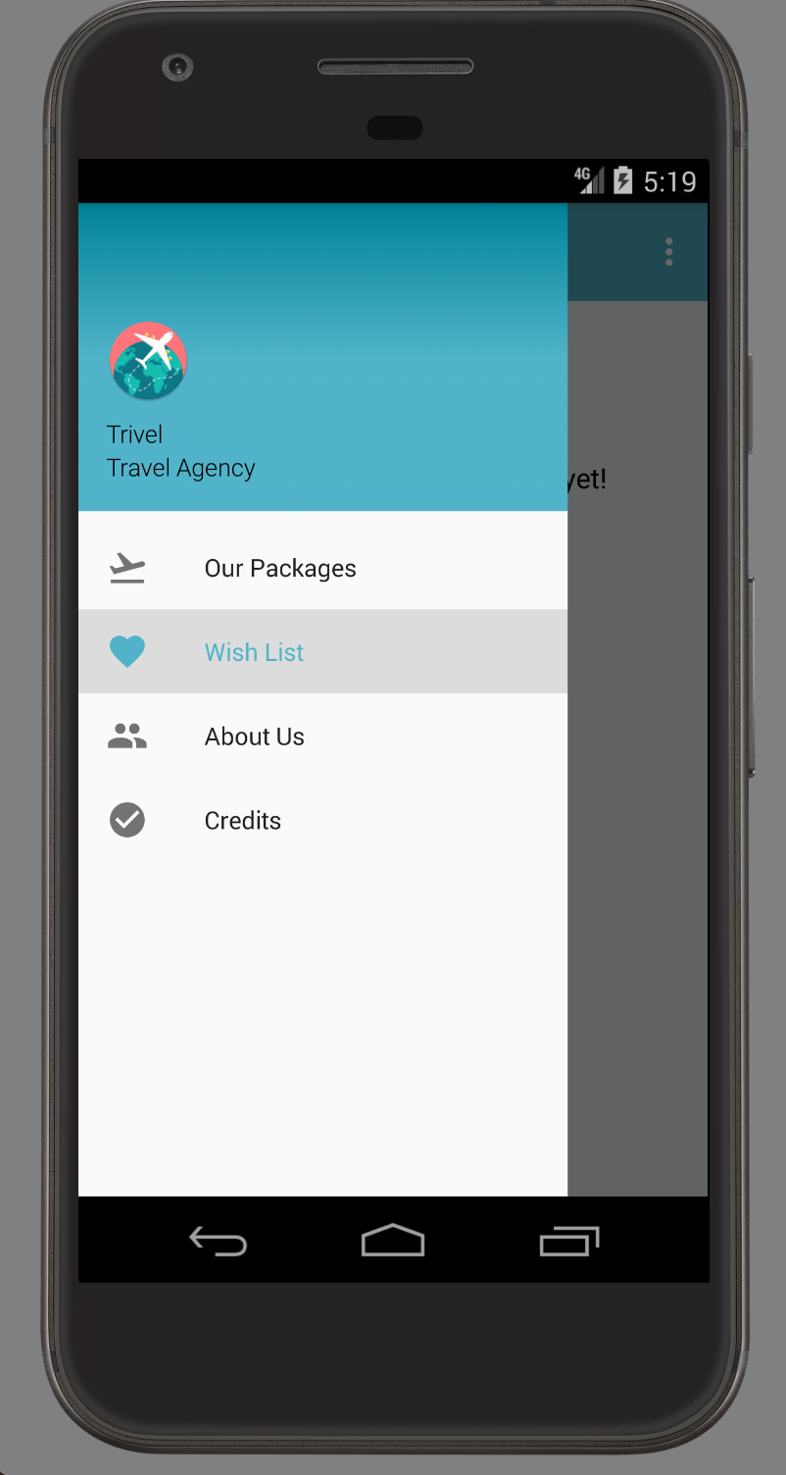
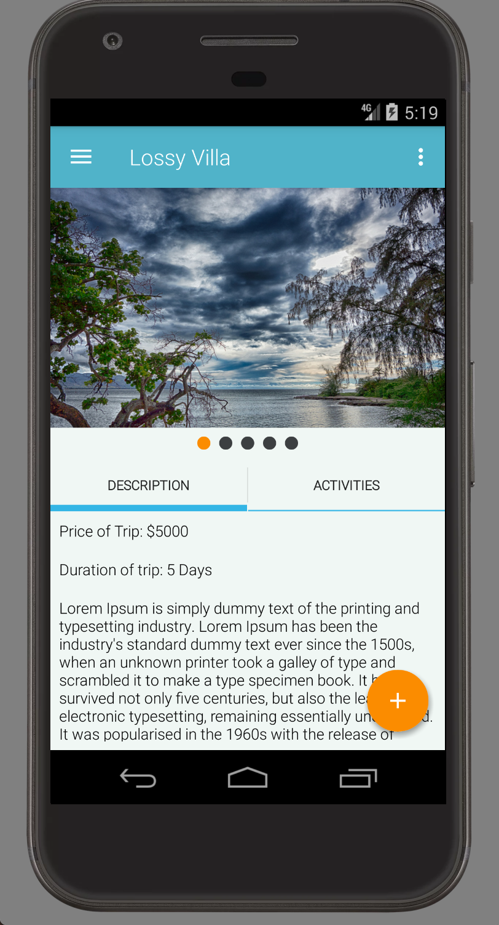
Week 3-4 Results

Slide 14
Weekly Break Down (Week 4)
Animations for recyclerViews and fragments
1
Some demo package were added and we started populating them in the app
2
Complete design of the about us page was created along with its functionality
3
We also went through the overall design and fixed an issue on the trip view which was fixed by adding a scroll view
4

Slide 15
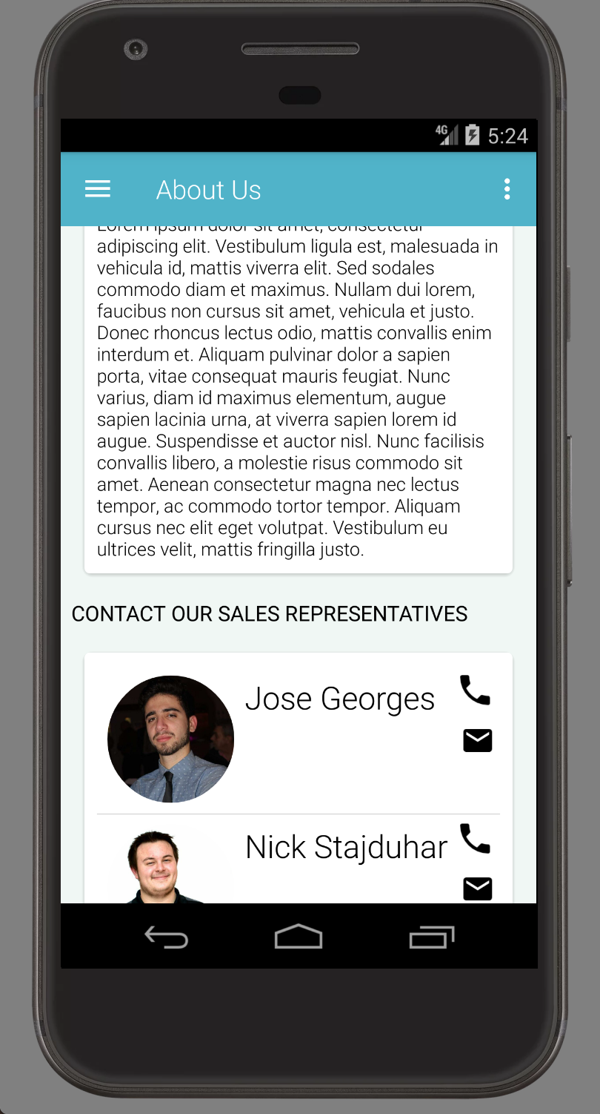
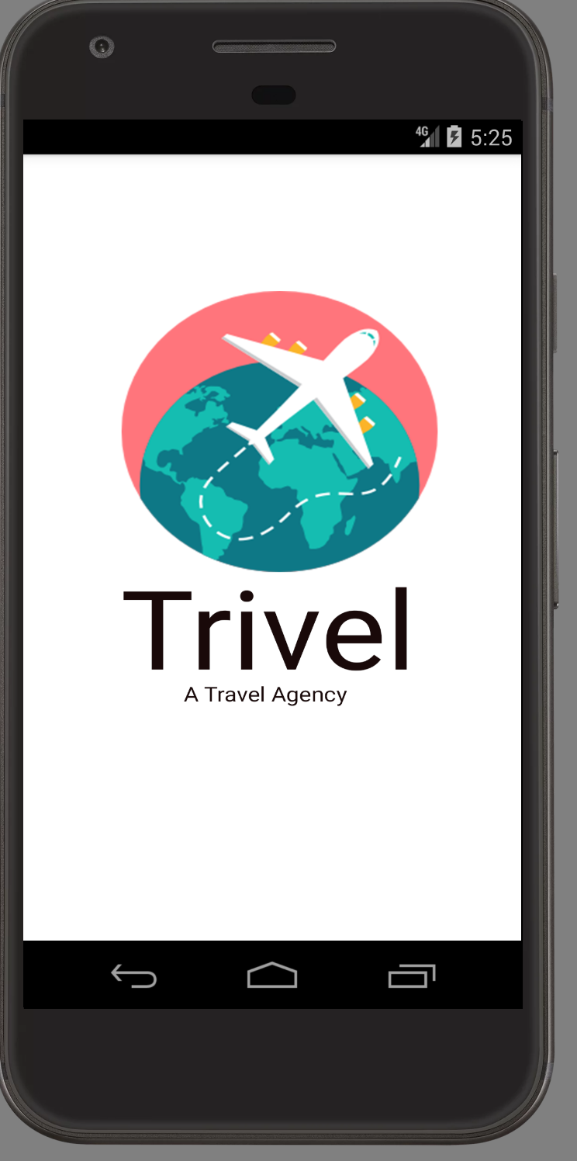
Week 4-5 Results

Slide 16
Weekly Break Down (Week 5)
Credits page added
1
Demo package were added and we populated them in the app
2
Translation to Spanish working
3

Slide 17
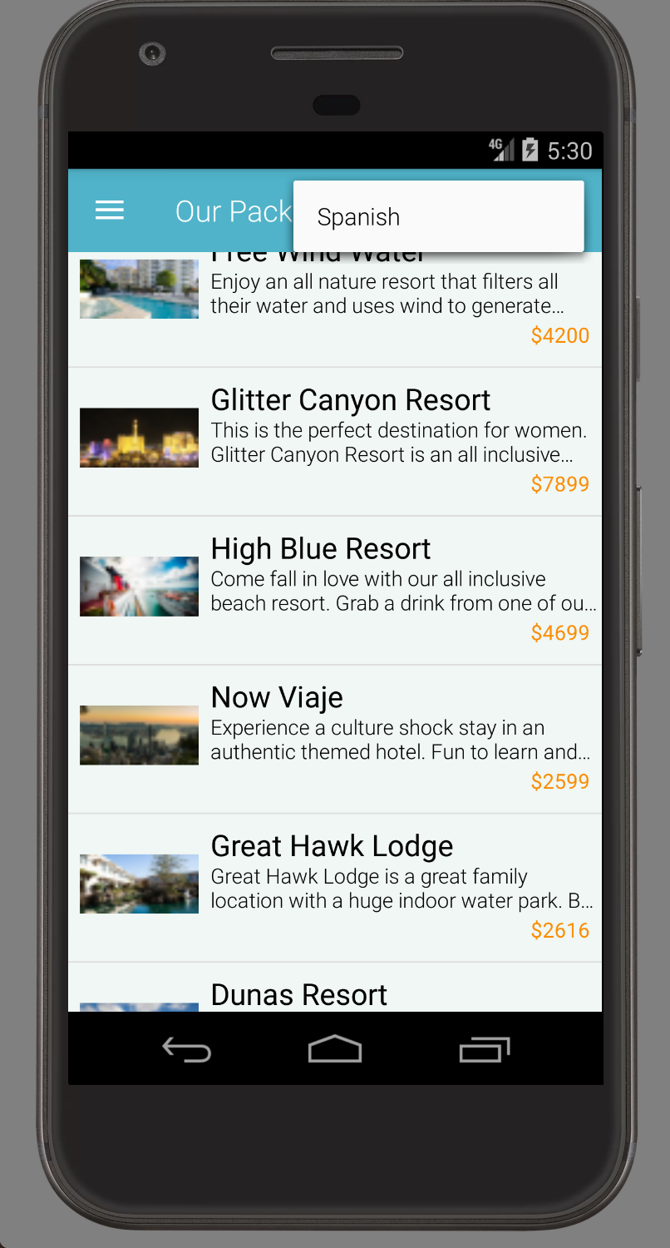
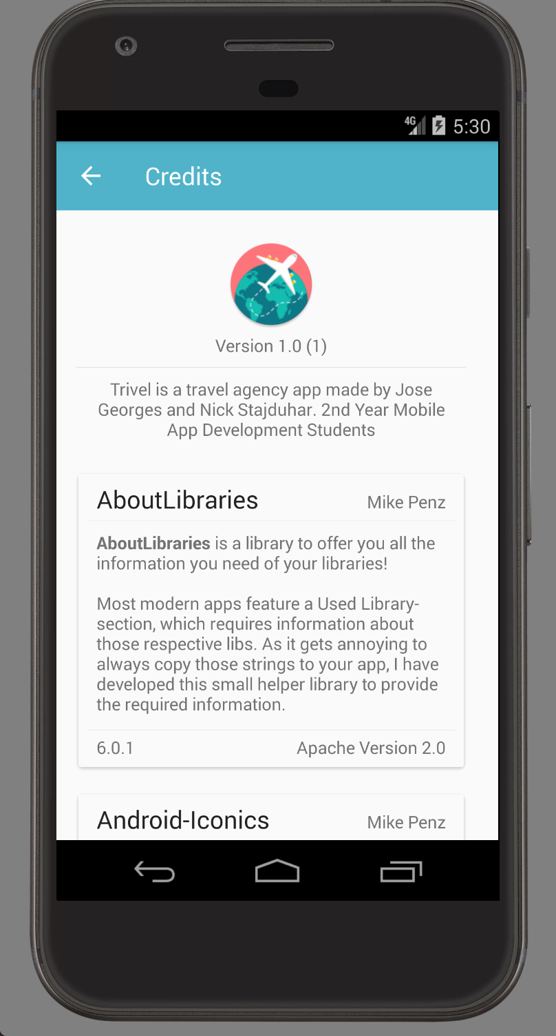
Week 5 Results

Slide 18
Issues we encountered
Lag
FAB disappearing
Passing Information between fragments

Slide 19
Lag
After talking with Cai he showed us a library called Picasso. Picasso is used to manage your images. It allows the images to load when they are needed rather than loading them all at once and causing a lot of lag. After implementing Picasso into our app the lag virtually disappeared

Slide 20
FAB Disappearing
When we added a scroll view to the trip view the FAB would disappear. We fixed this issue by changing the location of the scroll view and the FAB button reappeared and the issue was resolved

Slide 21
Passing information between Fragments
In between fragments we had to be able to pass to main things:
The Trip Package that the user pressed to a fragment that displays it.
The Trip Package to the wish list if the user wanted it.
For the first one, the solution path we took was to simply pass it as a bundle through FragmentTransactions.
For the second one, we ended up using an interface in between fragments, passing the whole Trip Package information into a Trip Package object and throwing this from the fragment, to the Main Activity, back to the Wish List, adding It into the ArrayList that populated the adapter for the recyclerView.

Slide 22
Overall Design
In the end our app ended up looking like we initially intended. There were a few minor changes in the trip view to make it a cleaner more professional look. We ended up using a TabHost instead of buttons to make it a cleaner design and more user friendly.

